Slide 1
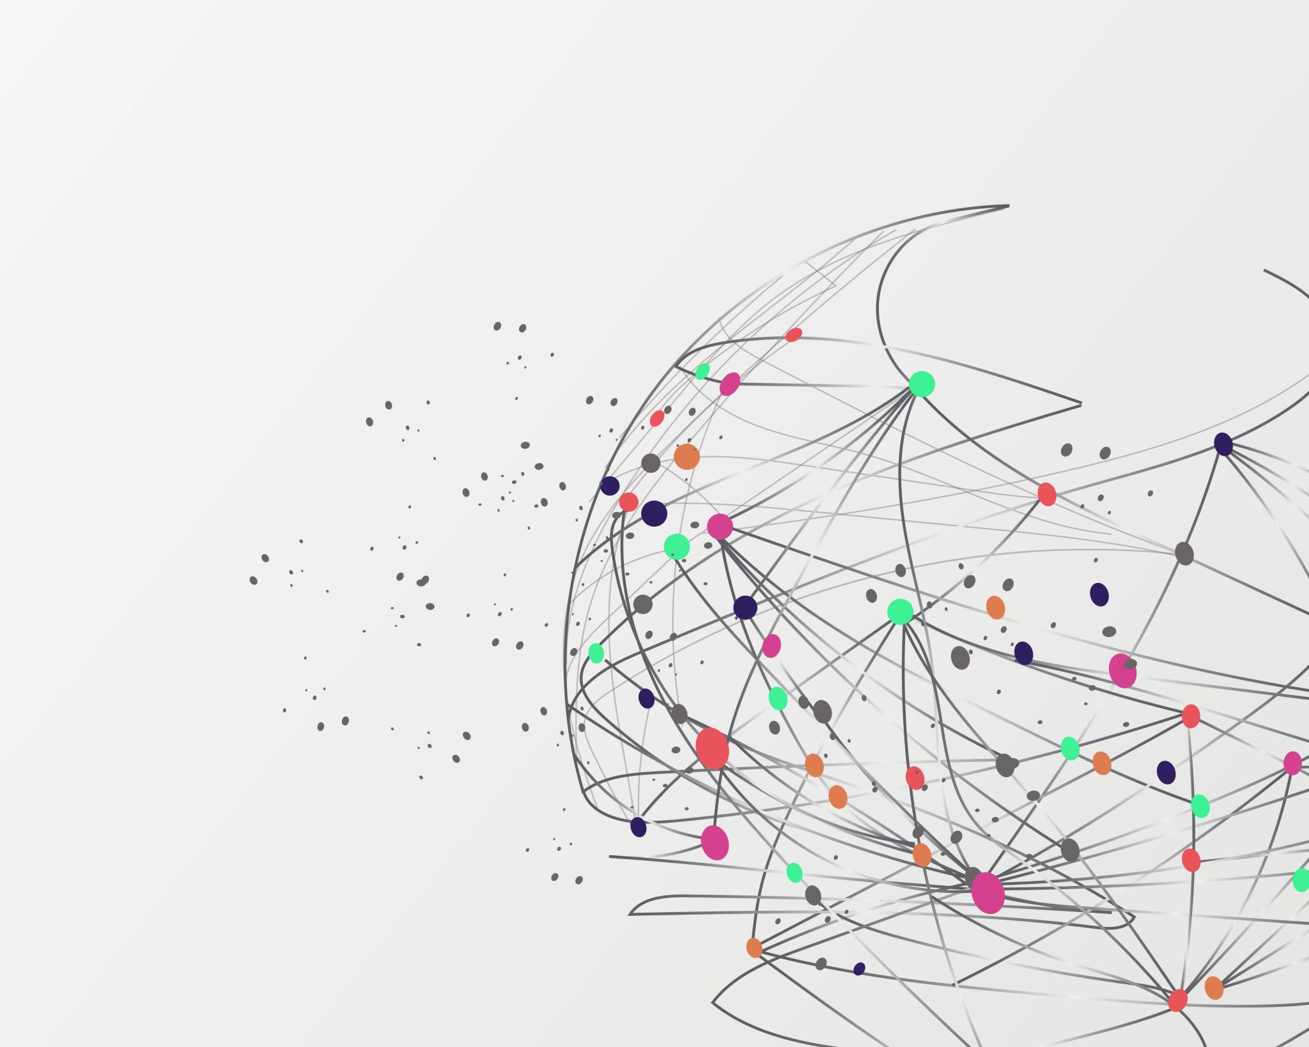
CF Lab 6
Introduction to Internet Basics

Slide 2

What is Internet?
The internet is a global system of interconnected computer networks that uses internet protocols to communicate between networks and devices
Notes:
Explain networks here

Slide 3
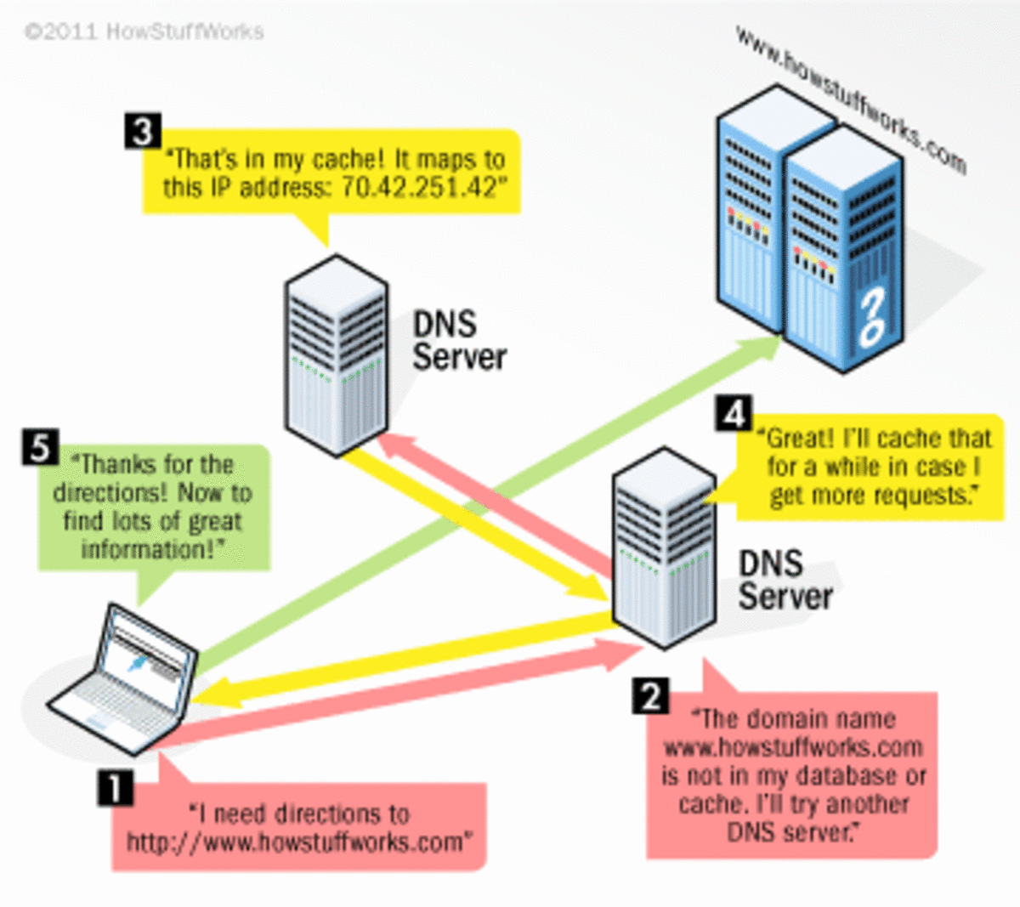
How does it Works?

Slide 4
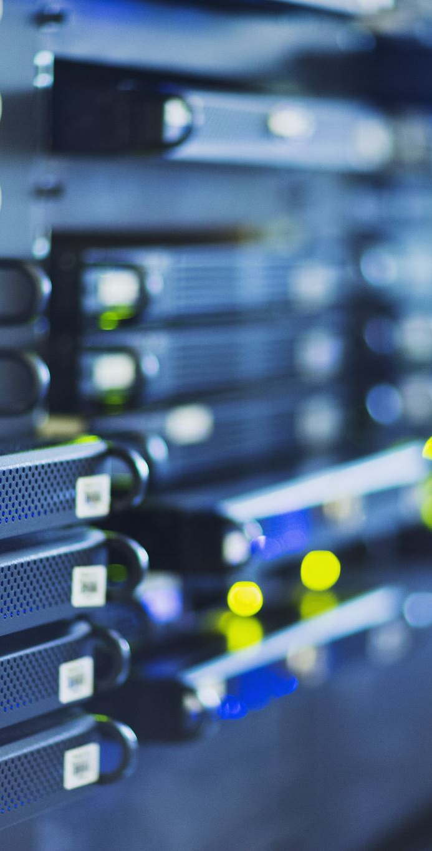
IP (internet Protocol)
To make communication possible IP was made
IP is a protocol; they are a set of rules that all parties must accept to communicate on the internet
IP defines the how data will travel and how it will be treated on the internet
Further will IP every device on the internet must have an IP address

Slide 5
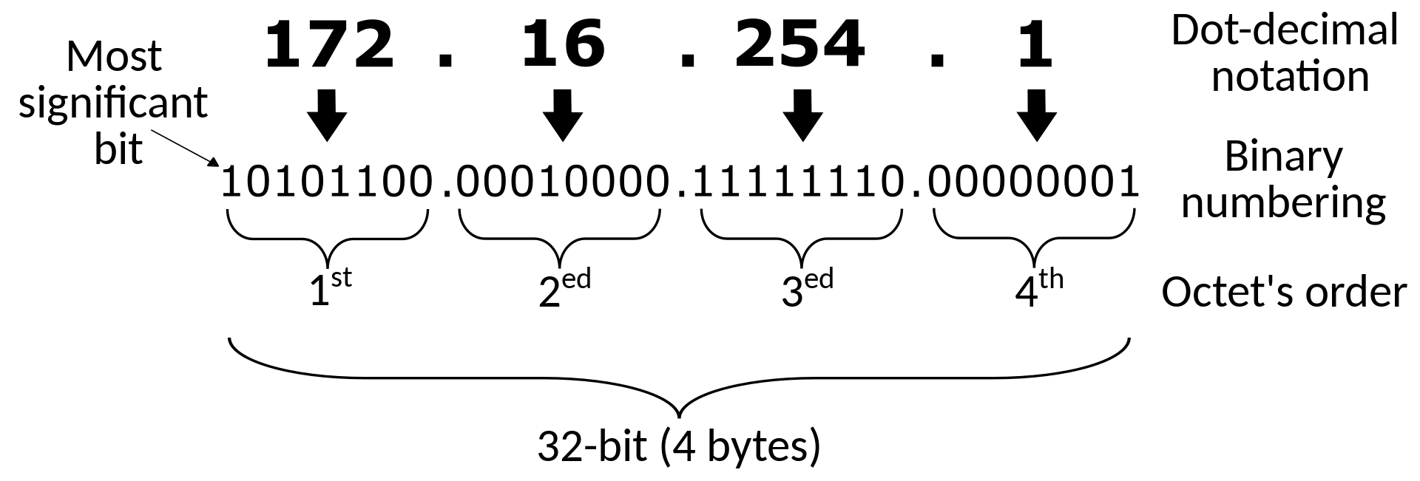
IP Addresses
Every devices on the internet have a unique address called IP address
Its just like your mailing address but in the form of a bunch of numbers
IPv4 supports 32bit addresses which totals to 2 billion devices support, but now we also have IPv6 which supports 128bit addresses that totals to 340 decillion devices
Notes:
Explain how each 8 bits is like defined into your device, subnetwork, subnetwork and network just like you home address have street, house etc

Slide 6
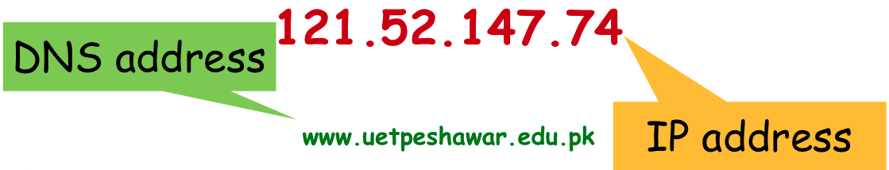
DNS?
As IP addresses grew and it was hard to keep track of each address so Domain Name System was developed each unique IP address is given a proper name so that it could be easily found on the internet

Slide 7
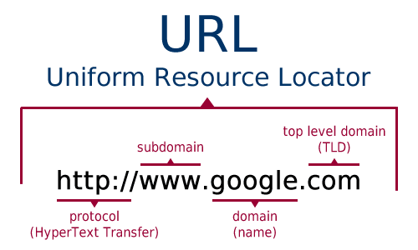
URL?
domain is the name given to an IP address, the proper address like www.google.com is called an URL
HTTP or HTTPS are two protocols with which your computer communicates with a server

Slide 8
MAC Addresses
As IP address are not permanent, they can be changed by changing locations, servers, routers etc
To solve this issue MAC address were introduced
Mac addresses are unique 48bit address that each electronic device that connect to the internet has
With this address they can be easily distinguishable on the internet.

Slide 9
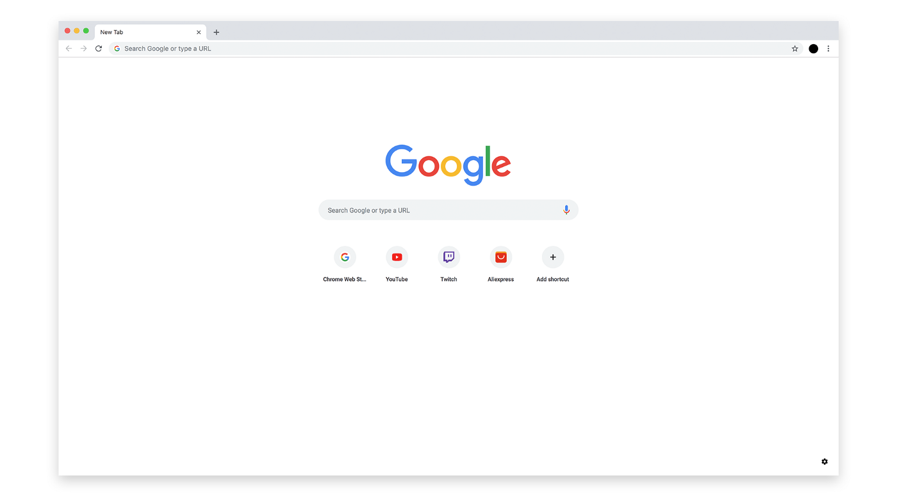
Web Browsers
Web browsers are applications software for accessing websites
They handles all the web rendering and helps run web apps code.
Also manages protocols and protects users from malicious sites and software
They have an address bars where you enter URLs to visit the webpages you wan.

